Slide 1


3
Helping International
Visitors in Beijing
practical cards
Through bilingual information cards for hospital visits, volunteer communication, and dining.
Jiabei He / 何佳倍
Sanlitun International Volunteer Service Project
small tools for real needs

Slide 2
More visitors mean more service needs
The project focuses on practical moments where language and process barriers become visible.
5.48M
+39%
Key question
How can volunteers help foreign visitors navigate Beijing more confidently in everyday situations?
inbound visitors in 2025
year-on-year growth
Source cited in the original deck: Beijing Municipal Bureau of Culture and Tourism.
Visitors need clear, low-friction information at the exact moment of difficulty.
Volunteers need simple English tools that can be used quickly.
The best solution should be portable, bilingual, and easy to test.
Sanlitun International Volunteer Service | Student Project
2/11

Slide 3
Research identified three service moments
Interviews and observations helped identify where visitors and volunteers get stuck.
Local volunteers
International students
Foreign visitors
Frontline helpers who understand common questions and communication gaps.
Longer-term residents who have repeated experience with Beijing services.
Short-term users who face pressure in unfamiliar scenarios.
Three recurring pain points
Hospital visits: procedures, departments, payment, and medicine collection.
Volunteer communication: simple questions can become difficult without ready phrases.
Dining: menus, allergies, spice levels, and etiquette are hard to explain.
Sanlitun International Volunteer Service | Student Project
3/11

Slide 4
Problem 1: Hospital visits can feel stressful
Medical service is high-stakes, so confusion creates anxiety quickly.
What makes it difficult?
Visitor insight
Visitors do not know how to register or choose the right department.
Even simple tasks can feel overwhelming when the process, vocabulary, and physical environment are new.
Payment, medical card, consultation, tests, and medicine collection are unfamiliar.
Translation apps are not always practical in urgent or emotional situations.
Sanlitun International Volunteer Service | Student Project
4/11

Slide 5
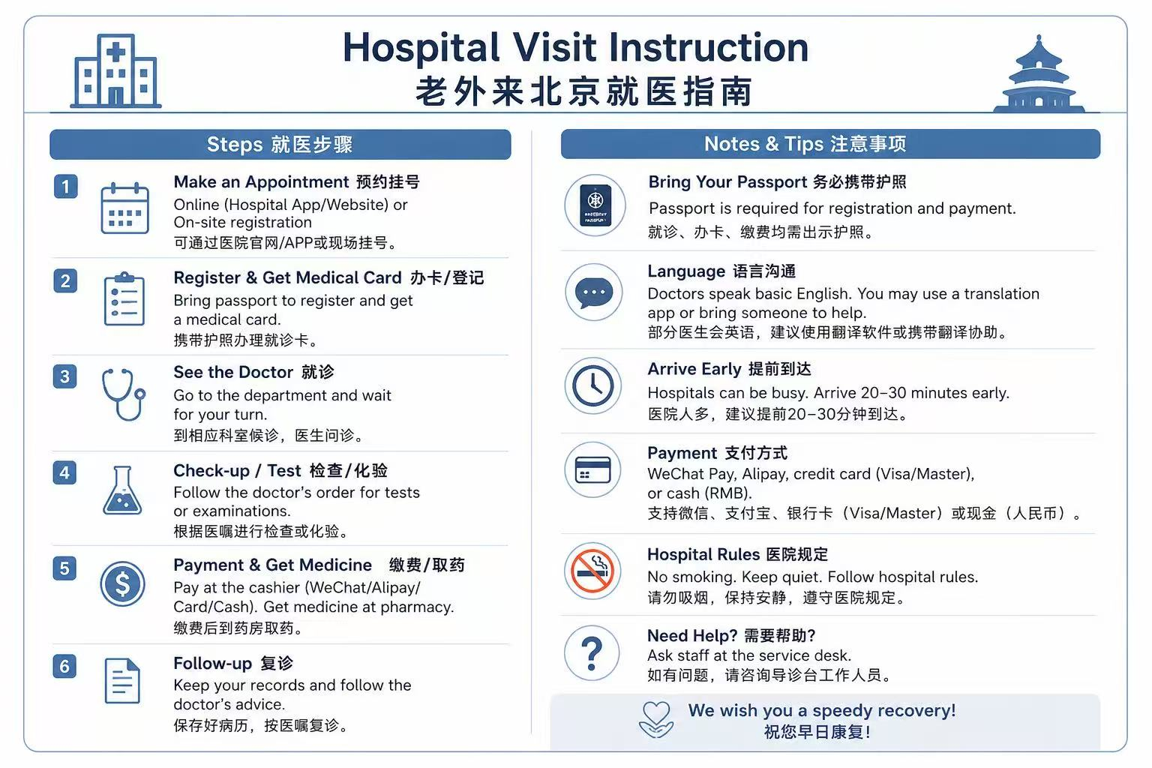
Solution 1: Hospital guide card
The card gives visitors a clear sequence before they ask for help.
What the card includes
Step-by-step hospital process from appointment to follow-up.
Passport, language, arrival, payment, rules, and help reminders.
Chinese and English wording to reduce uncertainty for visitors and volunteers.
Impact: less confusion and faster communication.
Sanlitun International Volunteer Service | Student Project
5/11

Slide 6
Problem 2: Volunteers need ready English
The challenge is not willingness; it is having ready language in the moment.
Volunteer limitations
Simple questions
Practical need
Some volunteers know the answer but are unsure how to say it clearly in English.
Directions, subway routes, prices, and nearby services need quick and accurate responses.
A phrase guide is more useful in service settings than a long formal English course.
The goal is to make first contact friendly, calm, and understandable.
Sanlitun International Volunteer Service | Student Project
6/11

Slide 7
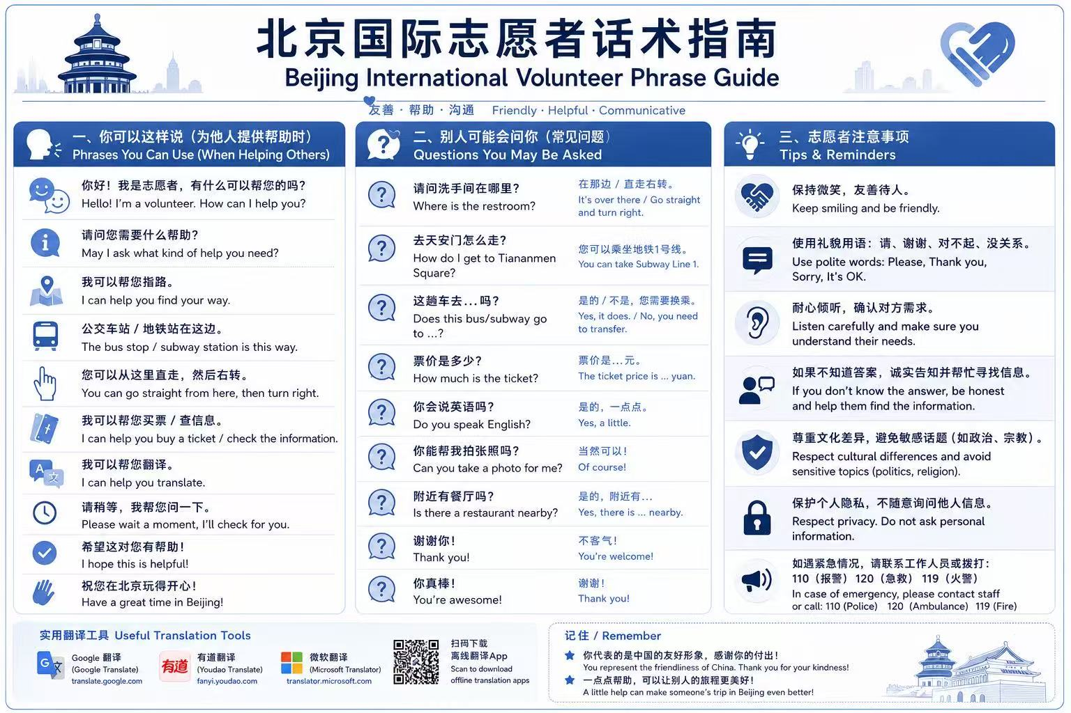
Solution 2: Volunteer phrase guide
It supports both what volunteers can say and what visitors may ask.
Design logic
Common helping phrases for directions, translation, tickets, and basic support.
Likely visitor questions with short response patterns.
Service reminders: smile, listen, be honest, respect privacy, and know emergency numbers.
Sanlitun International Volunteer Service | Student Project
7/11

Slide 8
Problem 3: Dining needs clear language
Dining should be enjoyable, but uncertainty can make it stressful.
Unfamiliar menus
Dietary restrictions
Cultural details
Dish names, ingredients, cooking methods, and spice levels are not always clear.
Allergies, vegetarian needs, halal food, or “no spicy” requests require precise language.
Payment, table manners, photos, and etiquette may feel uncertain to visitors.
A dining guide should make ordering safer, clearer, and more culturally comfortable.
Sanlitun International Volunteer Service | Student Project
8/11

Slide 9
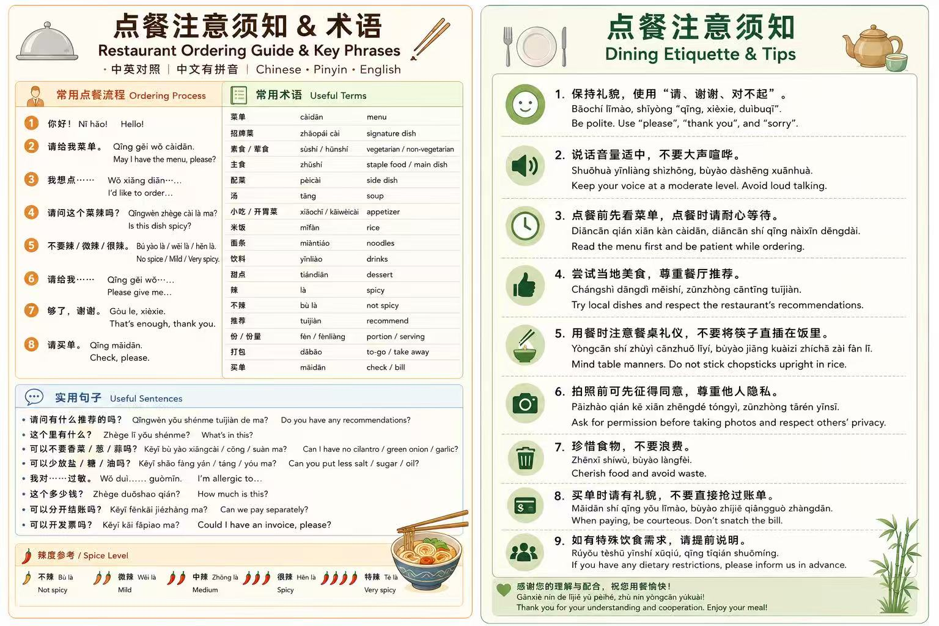
Solution 3: Restaurant ordering guide
The guide combines vocabulary, phrases, spice levels, and etiquette tips.
What visitors can use
Ordering process: menu, dish choice, spice level, bill, and invoice.
Useful terms: menu categories, staple food, side dishes, drinks, allergies.
Etiquette tips: polite language, moderate voice, photos, food waste, and dietary needs.
Sanlitun International Volunteer Service | Student Project
9/11

Slide 10
Three tools support real service moments
Each card turns a frequent difficulty into a concrete support tool.
Hospital support
Volunteer phrases
Dining guidance
For visitors: clearer steps and less anxiety in unfamiliar settings.
For volunteers: ready language and safer service boundaries.
For Beijing: a more welcoming international community.
Sanlitun International Volunteer Service | Student Project
10/11

Slide 11
Small cards make
Beijing warmer.
3
cards
Thank you for listening.
Jiabei He / 何佳倍
Helping international visitors starts with understanding their everyday needs.
11/11

